Slide 1
Section 10.2
Parametric and Polar Curves; Conic Sections
“Polar Coordinates”

Slide 2
All graphics are attributed to:
Calculus,10/E by Howard Anton, Irl Bivens, and Stephen Davis
Copyright © 2009 by John Wiley & Sons, Inc. All rights reserved.

Slide 3
Introduction
Sometimes, a point has an “affinity” for a fixed point, such as a planet moving in an orbit under the central attraction of the Sun.
In such cases, the path is best described by its angular direction and distance from the fixed point.

Slide 4
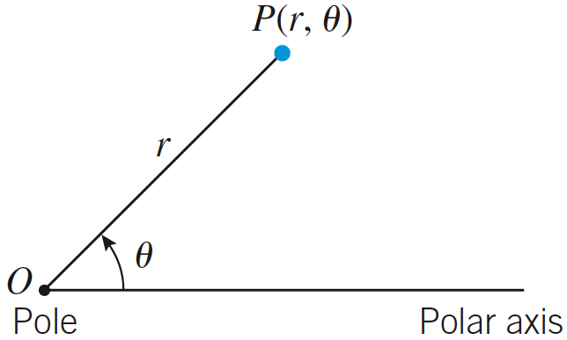
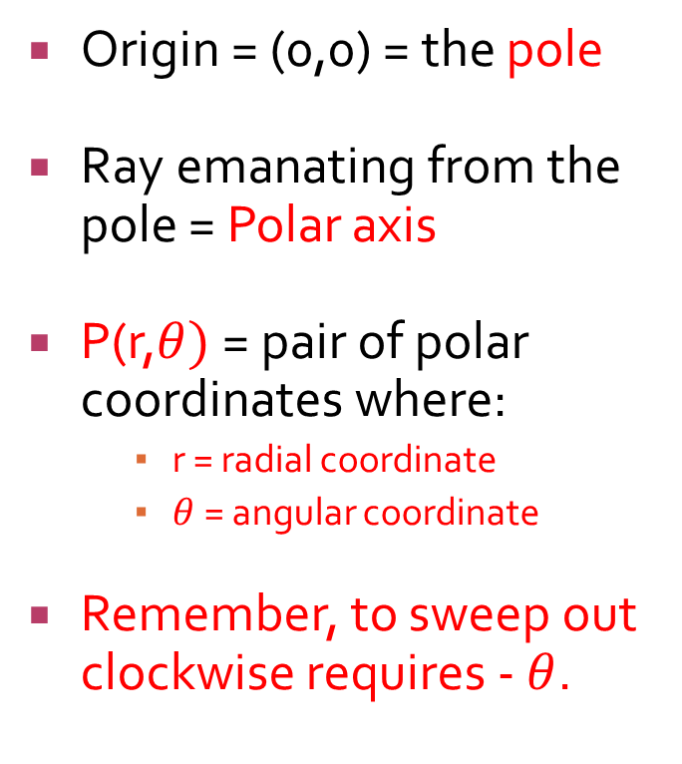
Polar Coordinate Systems
Origin = (0,0) = the pole
Ray emanating from the pole = Polar axis
P(r,$θ)$ = pair of polar coordinates where:
    r = radial coordinate
    $θ$ = angular coordinate
Remember, to sweep out clockwise requires - $θ$.

Slide 5
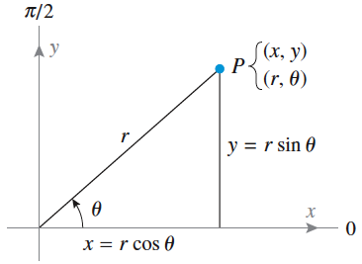

Relationship Between Polar P(r,$θ)$ and Rectangular (x,y) Coordinates
Sometimes, we may need to switch from one form to the other.
This can be done by “superimposing” a rectangular (x,y) coordinate plane on top of a polar coordinate plane.

Slide 6


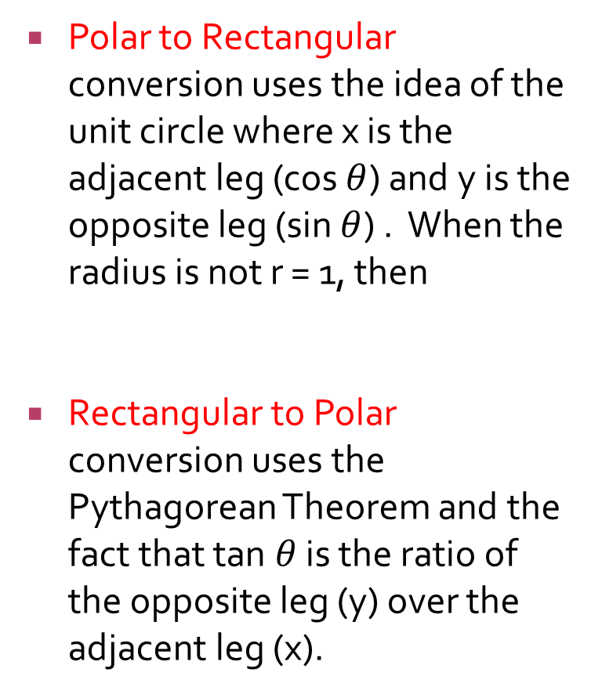

Converting Between Polar P(r,$θ)$ and Rectangular (x,y) Coordinates
Polar to Rectangular conversion uses the idea of the unit circle where x is the adjacent leg (cos $θ$) and y is the opposite leg (sin $θ$) . When the radius is not r = 1, then
Rectangular to Polar conversion uses the Pythagorean Theorem and the fact that tan $θ$ is the ratio of the opposite leg (y) over the adjacent leg (x).

Slide 7
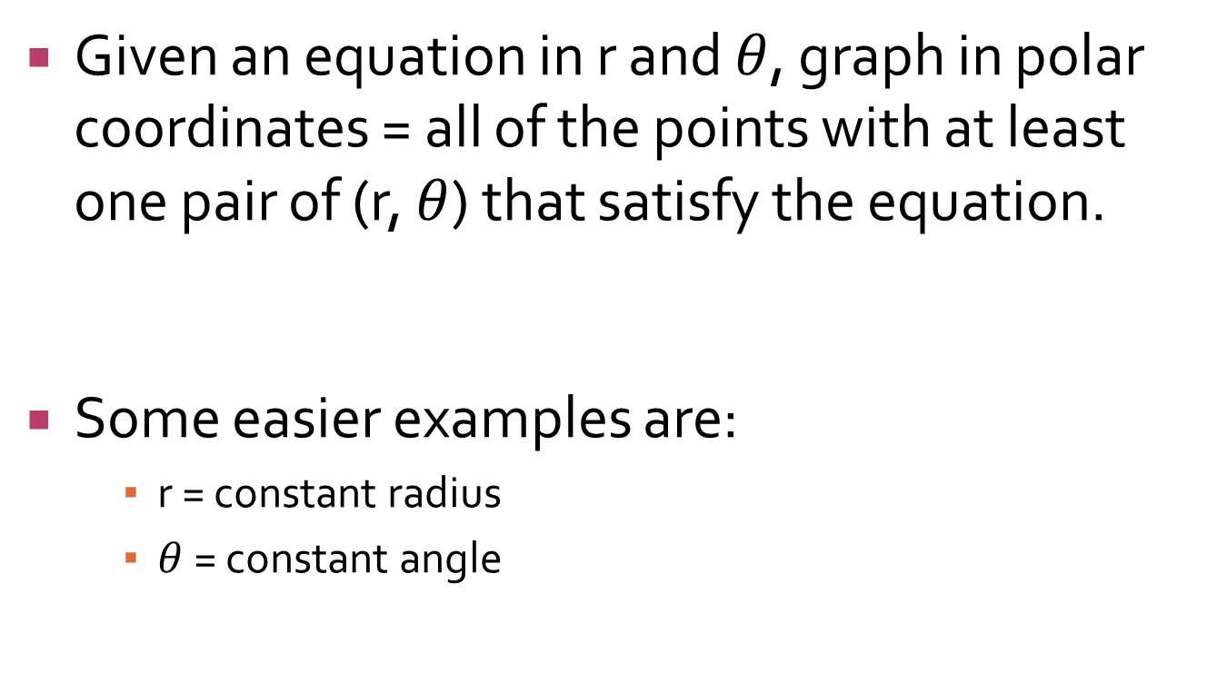
Graphs in Polar Coordinates
Given an equation in r and $θ$, graph in polar coordinates = all of the points with at least one pair of (r, $θ$) that satisfy the equation.
Some easier examples are:
    r = constant radius
    $θ$ = constant angle

Slide 8
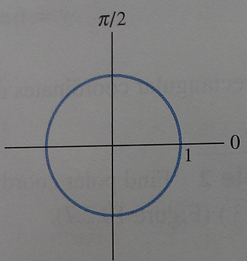
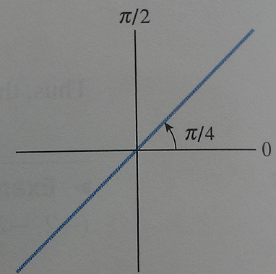
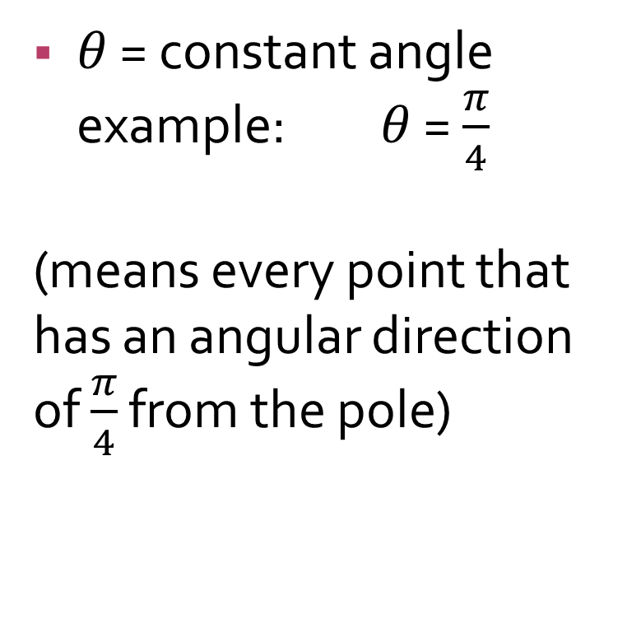
Examples of Graphs in Polar Coordinates
r = constant radius example: r = 1
(means every point that is one away from the pole)
$θ$ = constant angle example: $θ$ = $\frac{π}{4}$
(means every point that has an angular direction of $\frac{π}{4}$ from the pole)

Slide 9


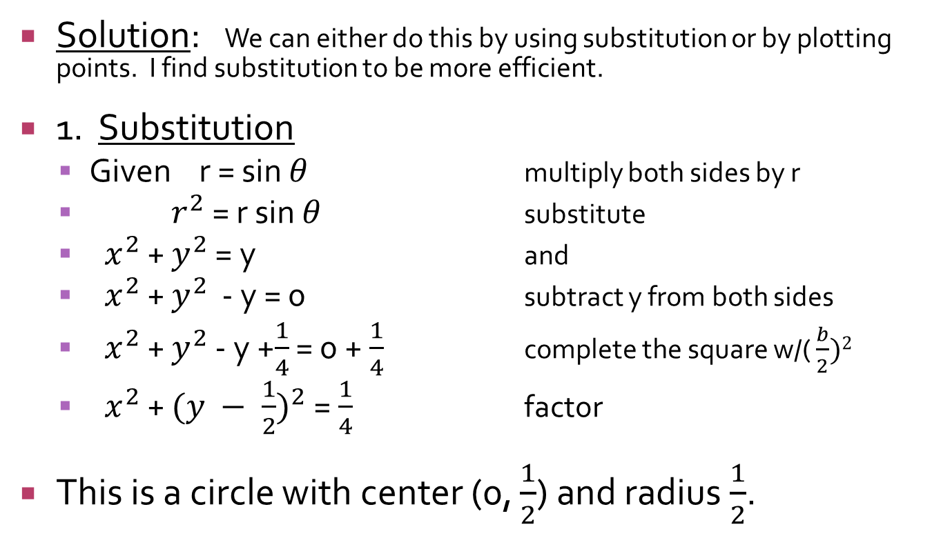

Sketch the graph of r = sin $θ$ in polar coordinates.
Solution: We can either do this by using substitution or by plotting points. I find substitution to be more efficient.
1. Substitution
  Given r = sin $θ$ multiply both sides by r
  $r^{2}$ = r sin $θ$ substitute
  ${ x}^{2}$ + $y^{2}$ = y and
  ${ x}^{2}$ + $y^{2}$ - y = 0 subtract y from both sides
  ${ x}^{2}$ + $y^{2}$ - y +$\frac{1}{4}$ = 0 + $\frac{1}{4}$ complete the square w/( $\frac{b}{2})2$
  ${ x}^{2}$ + ${(y − \frac{1}{2})}^{2}$ = $\frac{1}{4}$ factor
This is a circle with center (0, $\frac{1}{2}$) and radius $\frac{1}{2}$.

Slide 10
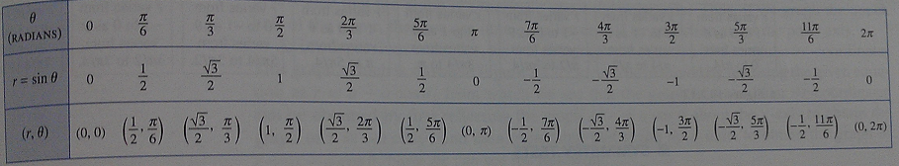
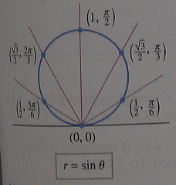

Sketch the graph of r = sin $θ$ in polar coordinates by plotting points.
When you plot these points,
they form a circle like we
found on the previous slide
through substitution.

Slide 11
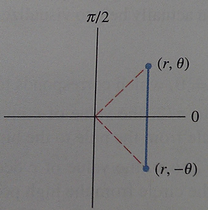
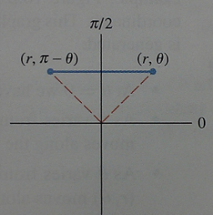
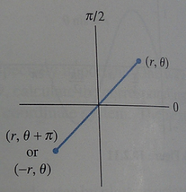
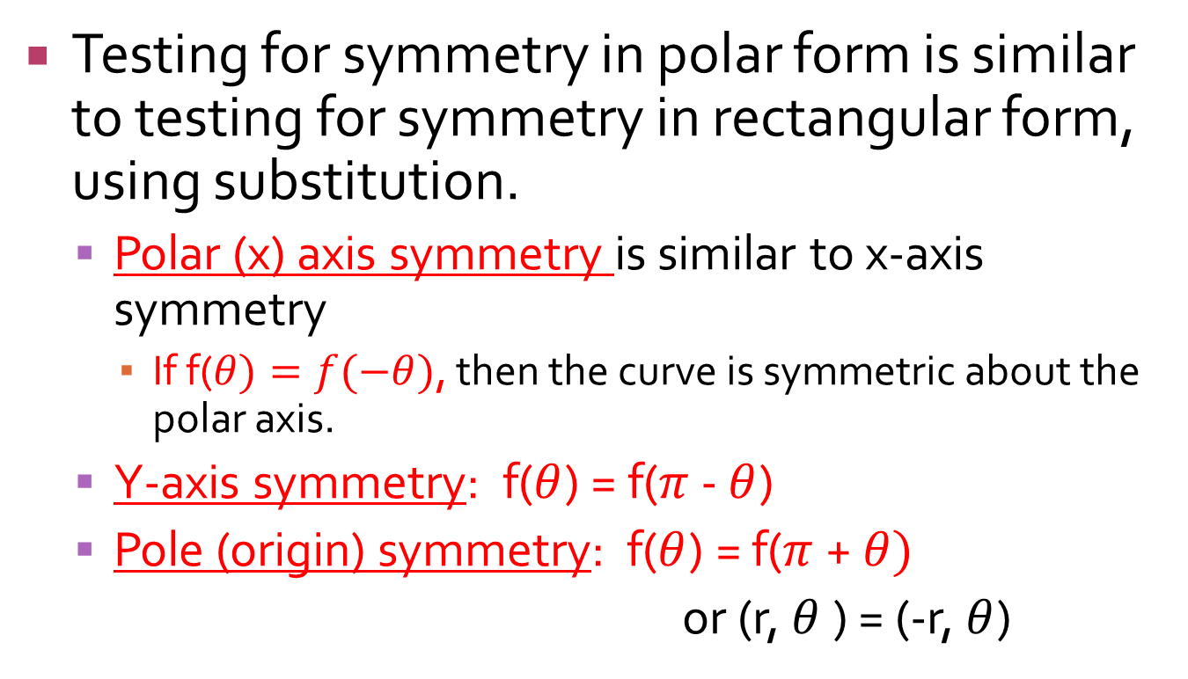
Symmetry Tests
Testing for symmetry in polar form is similar to testing for symmetry in rectangular form, using substitution.
  Polar (x) axis symmetry is similar to x-axis symmetry
    If f($θ)=f(−θ)$, then the curve is symmetric about the polar axis.
  Y-axis symmetry: f($θ$) = f($π$ - $θ$)
  Pole (origin) symmetry: f($θ$) = f($π$ + $θ)$
  or (r, $θ$) = (-r, $θ$)

Slide 12
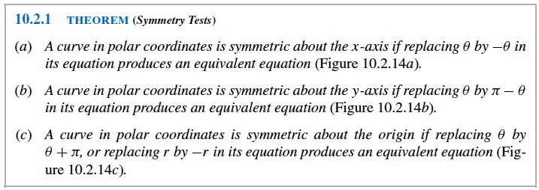
Formal Symmetry Tests Theorem

Slide 13
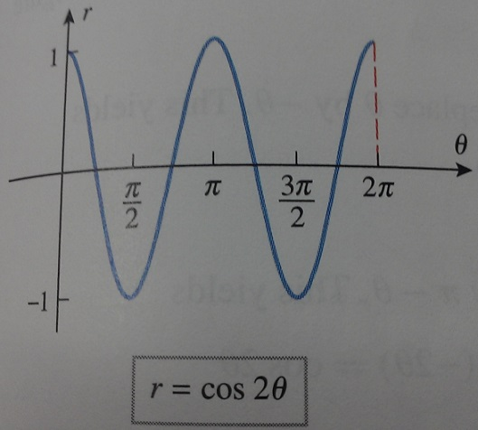
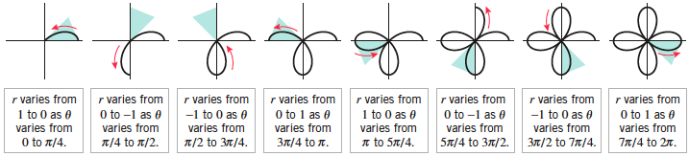
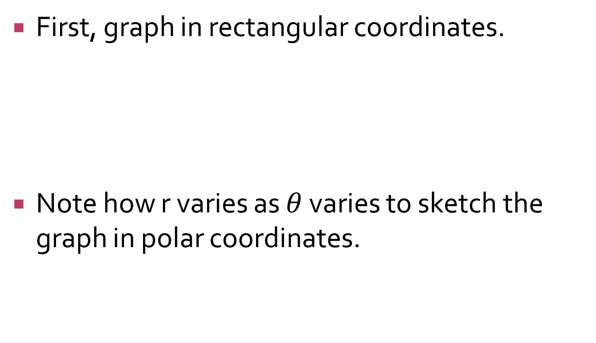

Sketch the graph of r = cos 2$θ$ in polar coordinates.
First, graph in rectangular coordinates.
Note how r varies as $θ$ varies to sketch the graph in polar coordinates.

Slide 14
Examples 8 & 9
Read examples 8 & 9 on pg 711-712 and we will go through it in class tomorrow. Do I need to have a quiz to make sure you did it?
Steps:
  1. Check for symmetry (saves so many steps)
  2. Rewrite equation in rectangular form
  3. Graph the equation in rectangular coordinates
  4. Use #3 to produce polar curve
  5. Use symmetry in #1 to reflect appropriately

Slide 15
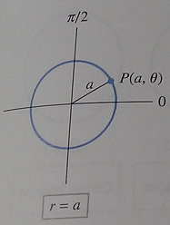
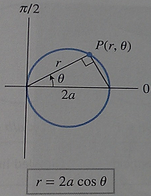
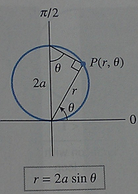
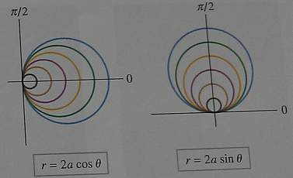
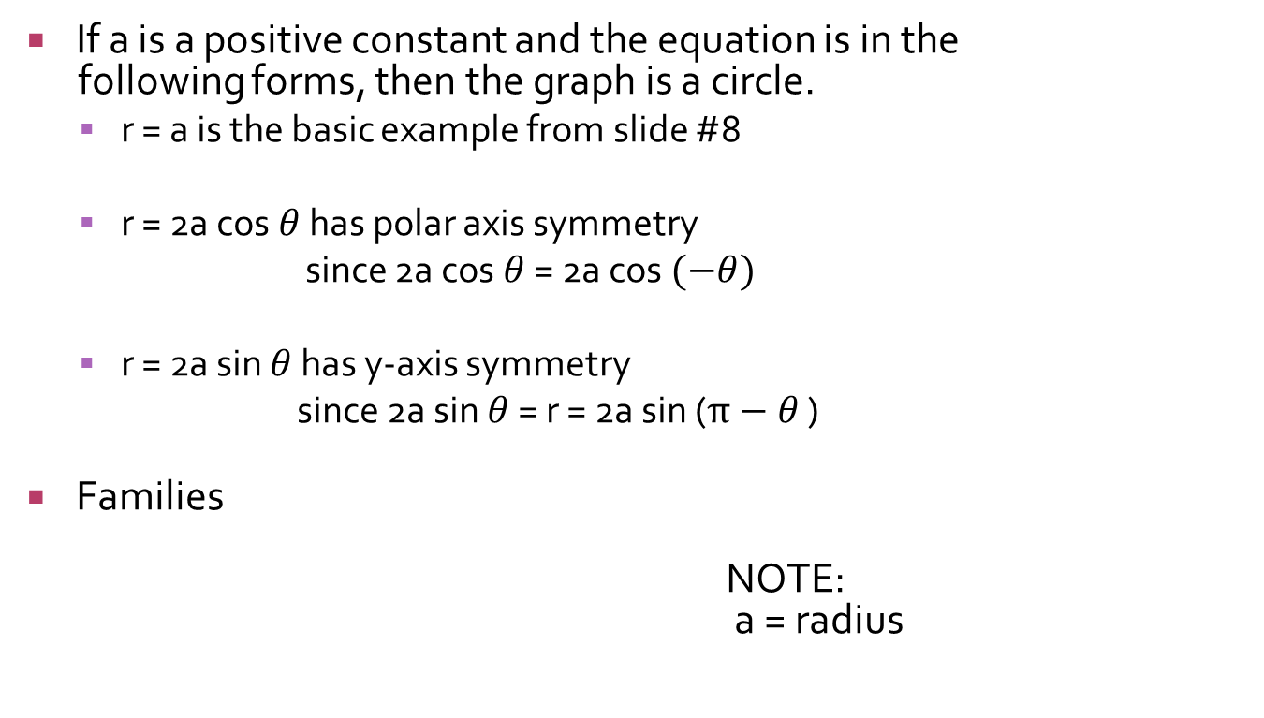
Families of Circles
If a is a positive constant and the equation is in the
following forms, then the graph is a circle.
  r = a is the basic example from slide #8
  r = 2a cos $θ$ has polar axis symmetry
  since 2a cos $θ$ = 2a cos $(−θ)$
  r = 2a sin $θ$ has y-axis symmetry
  since 2a sin $θ$ = r = 2a sin ($π−θ$ )
Families
NOTE:
a = radius

Slide 16
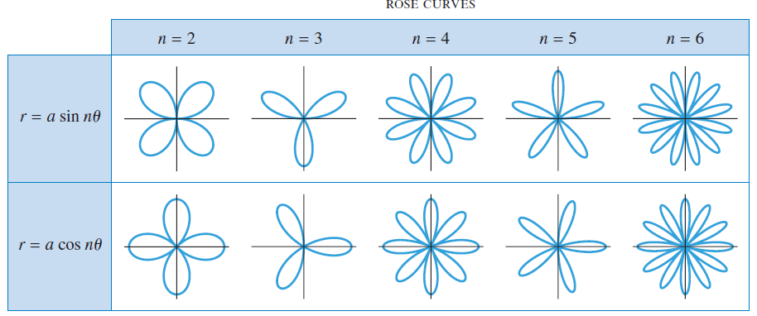

Families of Rose Curves
If a >0 and the equation is in the following forms, then the graph is a rose curve.
  r = a cos $nθ$ has polar axis symmetry
  r = a sin n$θ$ has y-axis symmetry
Number of petals
  If n is odd, the rose consists of n equally spaced petals of radius a.
  If n is even, the rose consists of 2n equally spaced petals of radius a.
  Asdf
  Jhjhgh
  Jkgbj
  Jhg
  A
  Af
same reason as circles

Slide 17
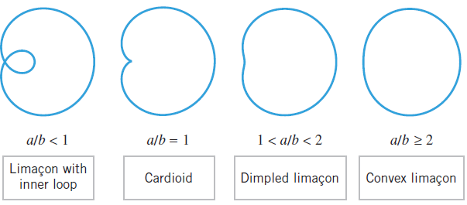

Families of Cardiods and Limacons
Equations with any of the four forms listed below with a>0 and b>0 represent polar curves called limacons.
  r = a + bcos $θ$ and r = a - bcos $θ$ have polar axis symmetry.
  r = a + bsin $θ$ and r = a - bsin $θ$ have y-axis symmetry.
Limacons have four possible shapes determined by the ratio a/b.
sd

Slide 18
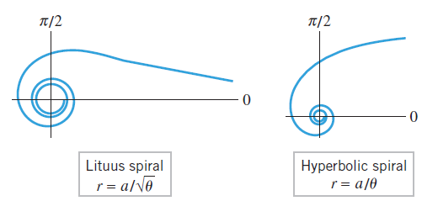
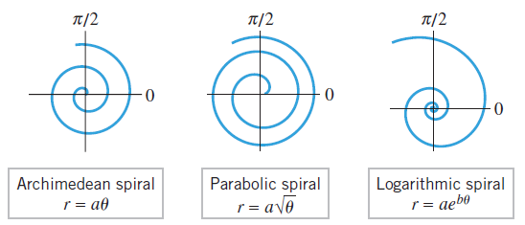
Families of Spirals
A spiral is a curve that coils around a central point.
Spirals generally have “left-hand” and “right-hand” versions that coil in opposite directions depending on the restrictions on the polar angle and the signs of constants that appear in the equations.
Below are some of the more common types of spirals, but you will not be tested on spirals.
Df
Sd

Slide 19
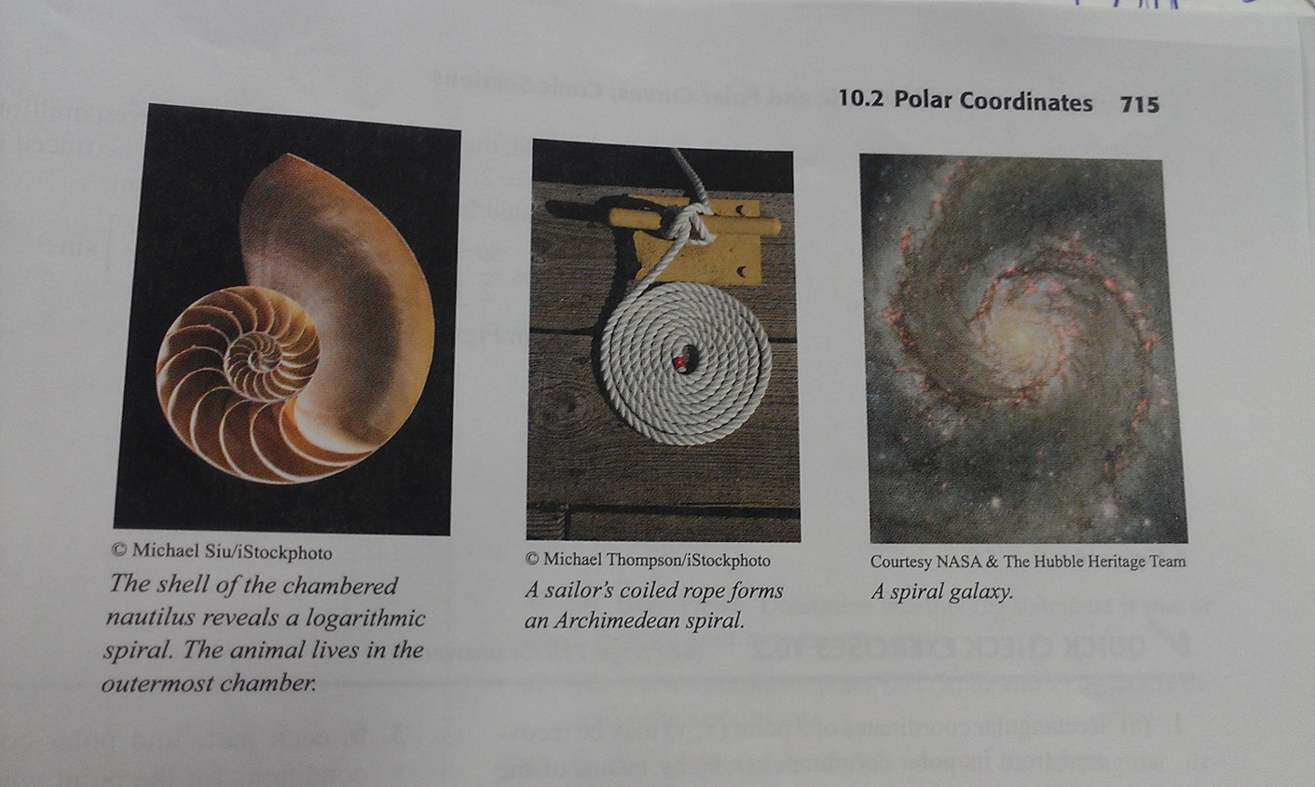
Spirals in Nature
Spirals of many kinds occur in nature: the shell of a nautilus, sailor’s rope, flowers, tusks, galaxies, etc.

Slide 20

Golden Gate Bridge
I recently biked across the Golden Gate bridge from San Francisco to Sausalito and Tiburon. This picture is on the ferry back to San Francisco.

